Slide 1


Our School Development Plan 2025-27
Shropshire Virtual School is the Education Champion in the Local Authority for children and young people in care to Shropshire. We can also provide advice around education for Previously Looked-After Children and those Children who have a Social Worker. We work hard to ensure that our children and those leaving care have the opportunities they need to fulfil their potential and improve their life chances. Our team promotes education, achievement and wellbeing and we influence policy and practice that affects our learners. We advise and work closely with schools/settings and other professionals such as social workers, independent reviewing officers, health and foster carers to support our children to fulfil their potential. The Virtual School provides training to professionals on matters that are important for our children - and we aim to improve our pupils’ access to services.
We also manage the Pupil Premium + budget and other Grants to target money towards the things our children need to be successful in their education, employment or training. It is important we hear their voice around the things that are important to them so we can act in their best interests. As we are part of the Corporate Parent for our children and young people in care, we are mindful to promote a way of working that asks the question “would this be good enough for my own child?”. A key part of our approach is that we promote high aspirations for all our learners, celebrating their achievements across a wide range of activities and as a service we aspire to be “a safe and reassuring pair of hands” providing “the right support in the right place at the right time”. This plan does not describe all the activities we undertake to support our children and young people, it shows our targeted areas for development in this period.
Our Plan is reviewed termly and will be refreshed in Summer 2026 for 2026-27 in order to be responsive to change.

Slide 2
Our school development plan
Leadership & Management
Shropshire VS will have a fully resourced team to meet our children’s needs, with staff who are passionate about improving outcomes for our children.
As a school we live up to our ‘heart’ values as having courage to grow, valuing every voice, reaching out to connect, being a safe and reassuring pair of hands and providing the right support in the right place at the right time.
There will be robust data capture to support analysis, action and reporting – and the school will perform well on KPIs.
Our children & partners will know who we are, what we do, feel supported and feel that they have a voice in shaping our service offer.
We will work towards achieving the National Nurturing Schools Programme accreditation.

Slide 3
Our school development plan
The school will be fully resourced to meet the needs of our learners and will function effectively, also minimising any single points of failure by building a new layer in the school structure for Senior EASOs and enhancing our distributed leadership approach
We will continue to develop & deliver a high-quality training offer with the aim of supporting settings to become attachment & trauma responsive. We will extend & develop the Emotion Coaching, Nurture and Hearts and Minds projects focusing on relational practice and inclusion for our three ‘families’ of children and young people.
We will ensure the school works with partners to align with new guidance and reforms eg Best Start in Life, Families First Partnership and SEND Reform, building on good practice in our team and cross our partnership with the Education Access Service (EAS)
Data tracking and reporting will be further developed so we can tell how we make a difference and our KPIs will be in line with or better than National and other relevant Averages.
We will drive the Inclusive Attendance Project with EAS and be ambitious for attendance of 92.5%, plus refresh our Attendance Policy and focus on effective use of Reduced timetables, develop additional inclusion projects / partnerships with alternative providers to increase offers on our PP+ Support Map and reduce suspensions.

Slide 4
Our school development plan
We will develop new projects / interventions to Improve academic outcomes and support learning at home, especially in speech and language for early years and English/maths for primary and secondary learners
We will target PEP completion to increase to 98% and quality to 95% across the school. Our Children in Care Council will support how the PEP develops to embed nurture principles.
We will progress our work experience offer take up in the family business, develop employability projects and develop opportunities for engagement with higher education; we will also revise and update our strategic plan for using the new Post 16 PP+ Grant effectively to support attendance, attainment and retention.
We will support our children and young people to co-develop their new Children in Care Council and create the new ‘Jaz-prentices’, both of these will give opportunities for their voices to be heard louder and more widely.

Slide 5
Our school development plan
We will re-develop the social emotional and mental health scales in our PEP in relation to supporting positive mental health of our Shropshire Children in Care and develop strategic partnerships with Health in order to improve health and well-being outcomes.
We will Develop use of the Boxall Profile across the school (NNSP) to support a graduated approach for inclusion & align this with support for social emotional and mental health in our PEP
We will ensure our school team are well supported and have excellent opportunities for professional development, also reviewing our approaches to wellbeing and Induction
We will evolve the STREAM project to support our Key Stage 5 pupils into education, employment and training – and look to use this model to support other approaches to reducing pupils in Key Stage 5
We will develop and deliver a robust Training Offer to Social Workers, Designated Safeguarding Leads & SENCOs to support promoting achievement and inclusion of CWSW – and we will develop robust integrated working to ensure education is a priority area in Child in Need and Child Protection Plans.

Slide 6
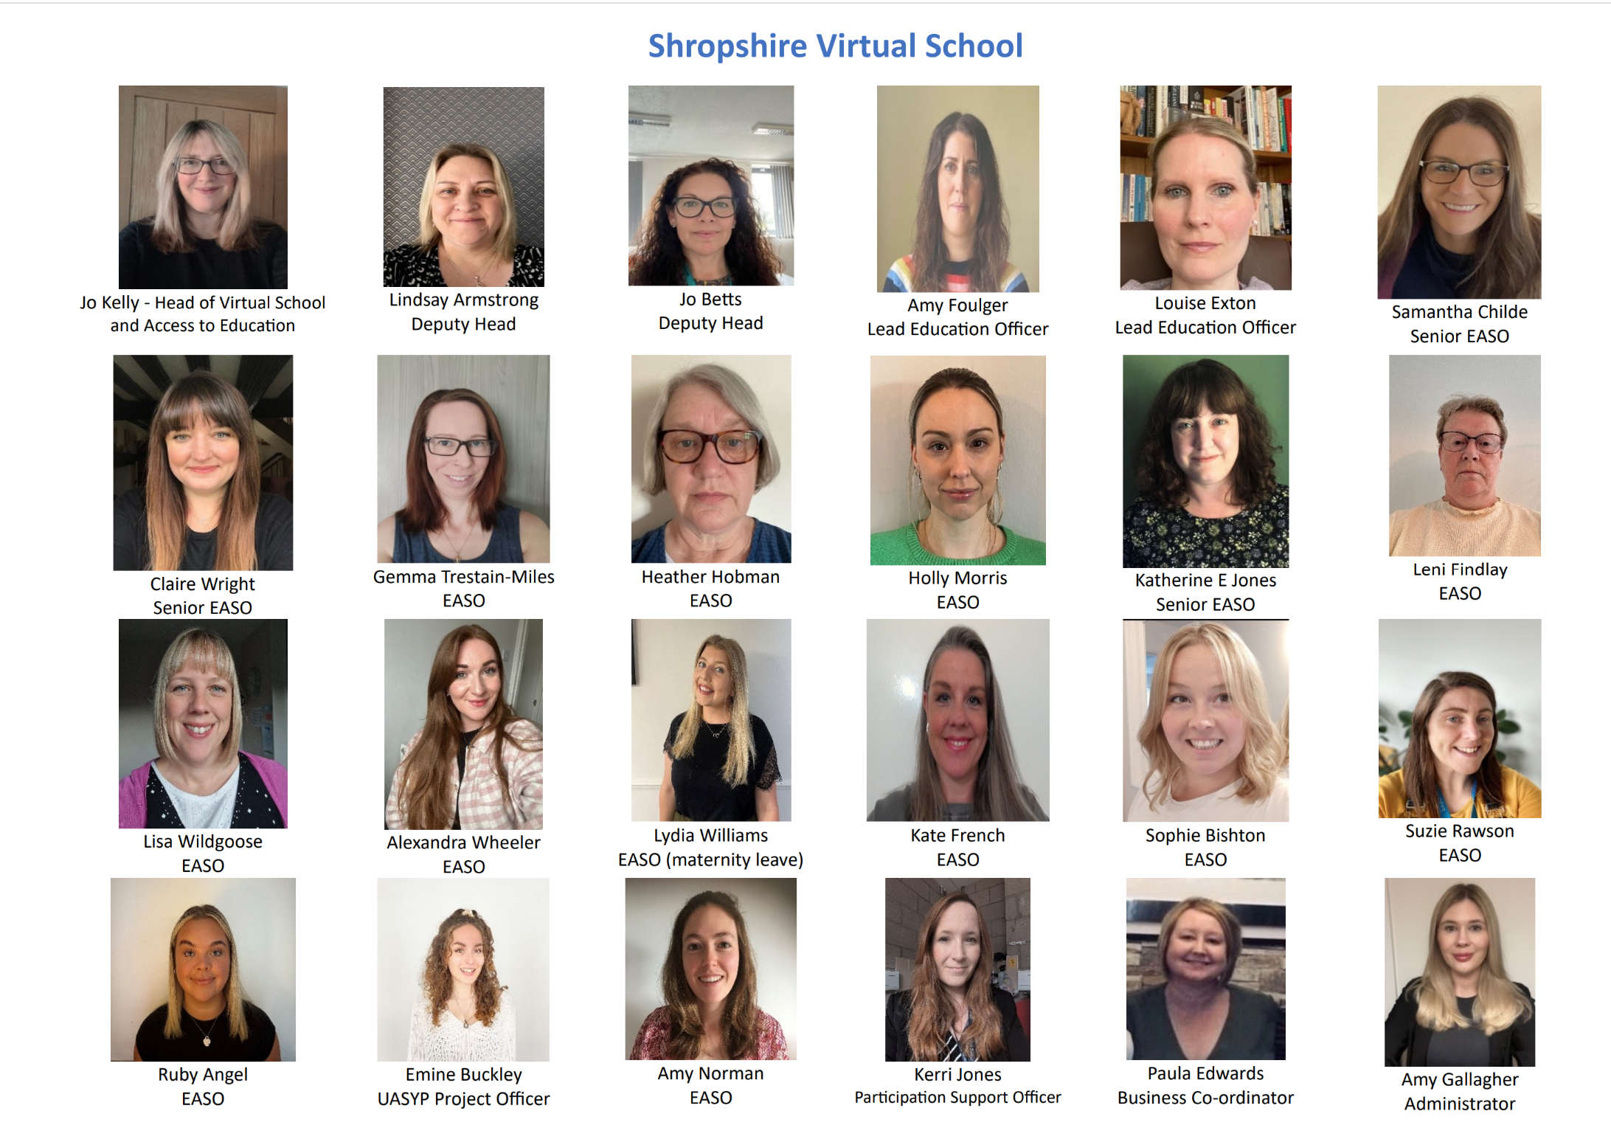
Our Virtual School Team

